Slide 1
Spotify Songs’ Genre Segmentation
A Machine Learning Approach to Music Classification

Slide 2
INTRODUCTION
Spotify recommends songs based on user preferences.
Genre segmentation helps in better music recommendations.
Machine Learning clusters songs based on their audio features.

Slide 3
Objective
Group songs into genres using audio features.
Understand musical patterns through clustering and classification.

Slide 4
Dataset Description
Source: Spotify Dataset (Excel Macro-Enabled File).
Features: Danceability, Energy, Tempo, Loudness, Valence, etc.
Target: Genres or clusters derived from features.

Slide 5
Data Preprocessing
Handle missing values.
Standardize features (e.g., Min MaxScaler).
Encode categorical variables if needed.

Slide 6
Exploratory Data Analysis
Distribution of features (histograms).
Correlation heat map of audio features.
Key insights: Similar genres share common feature patterns.

Slide 7
Model Building
Unsupervised Learning: K-Means Clustering, Hierarchical Clustering.
Dimensionality Reduction: PCA for visualization.
(Optional) Supervised Learning: Random Forest / SVM if labels exist.

Slide 8
Model Performance
Silhouette Score / Davies-Bouldin Index for clustering.
Visualization of clusters using PCA or t-SNE.

Slide 9
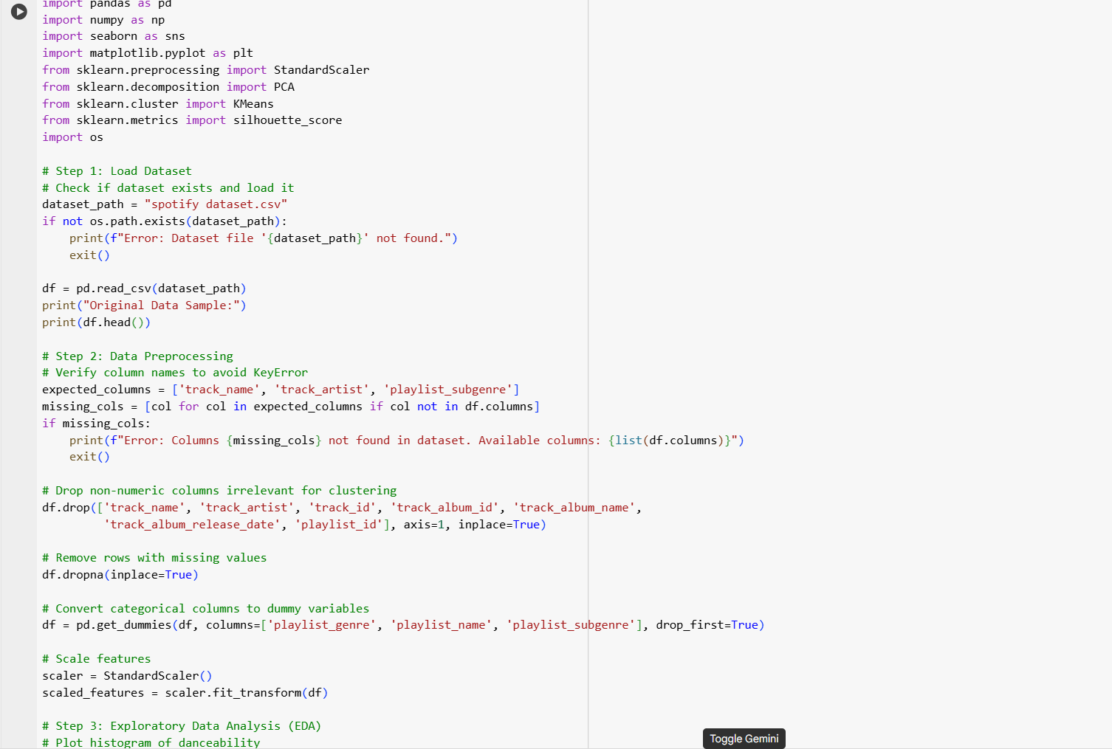
PROGRAM

Slide 10
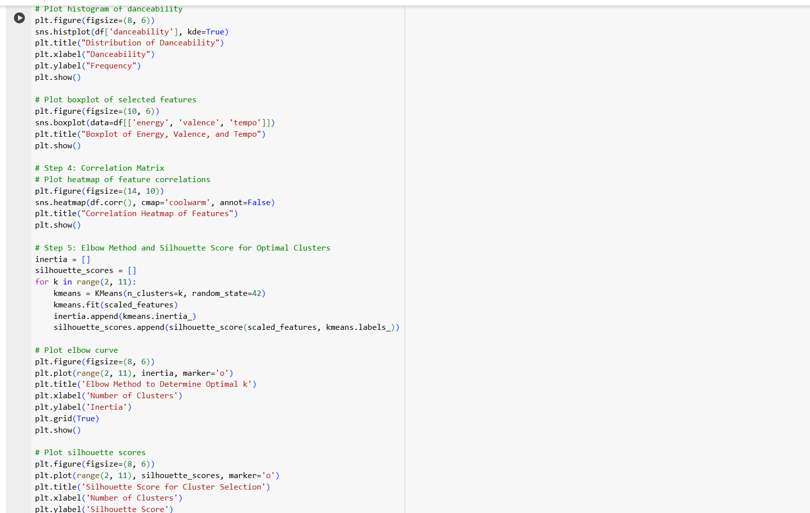

Slide 11
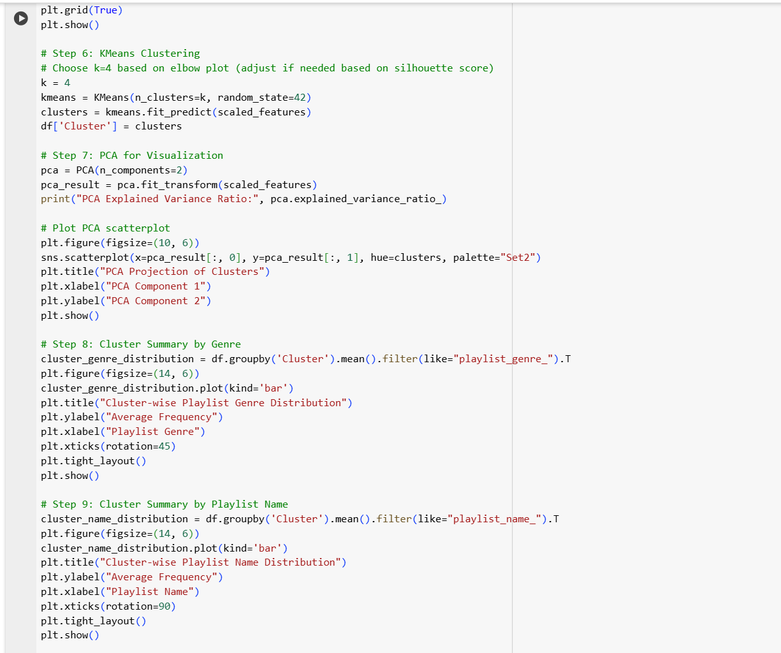

Slide 12
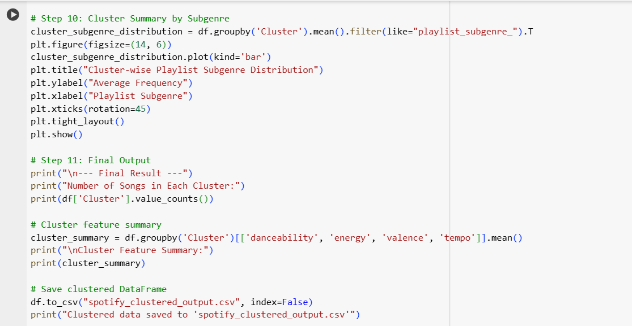

Slide 13
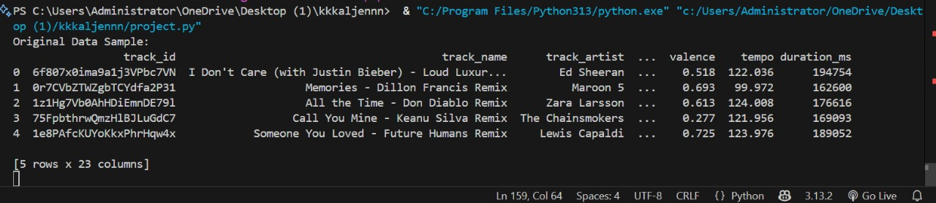

Slide 14
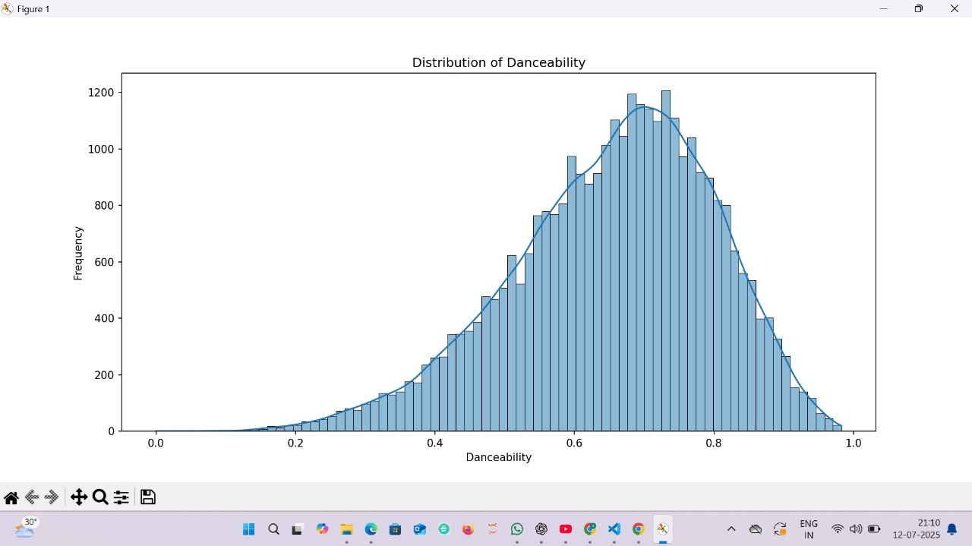

Slide 15
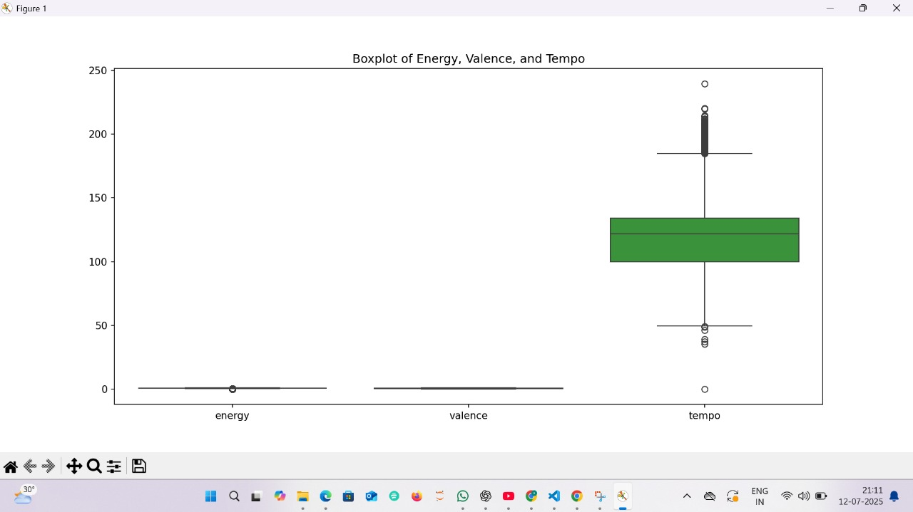

Slide 16
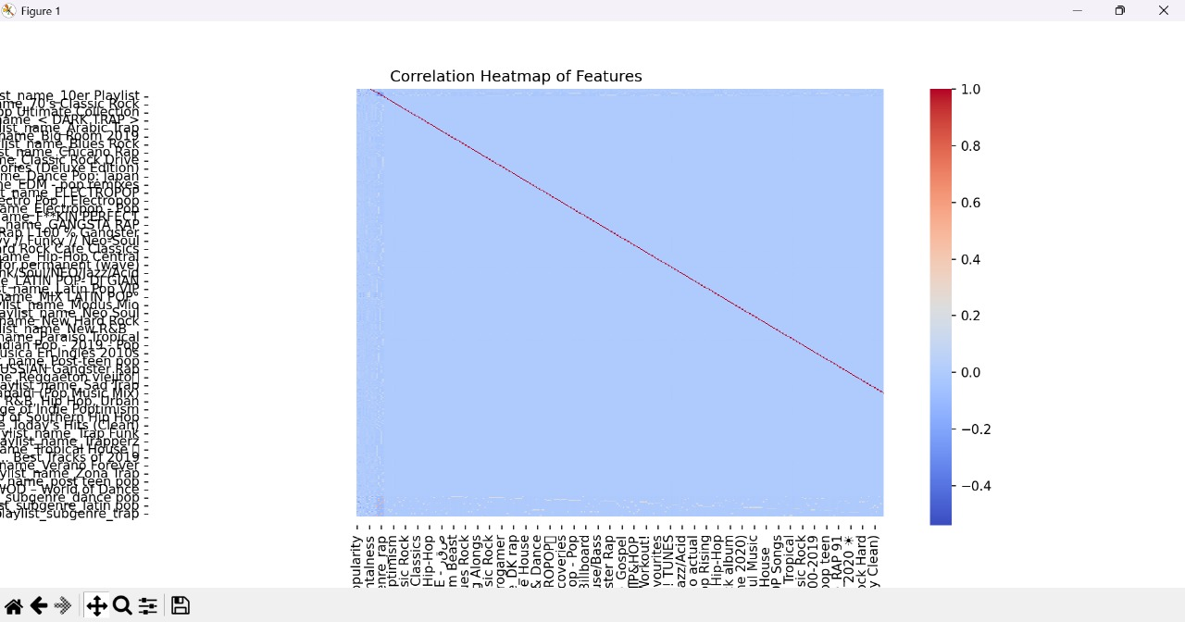

Slide 17
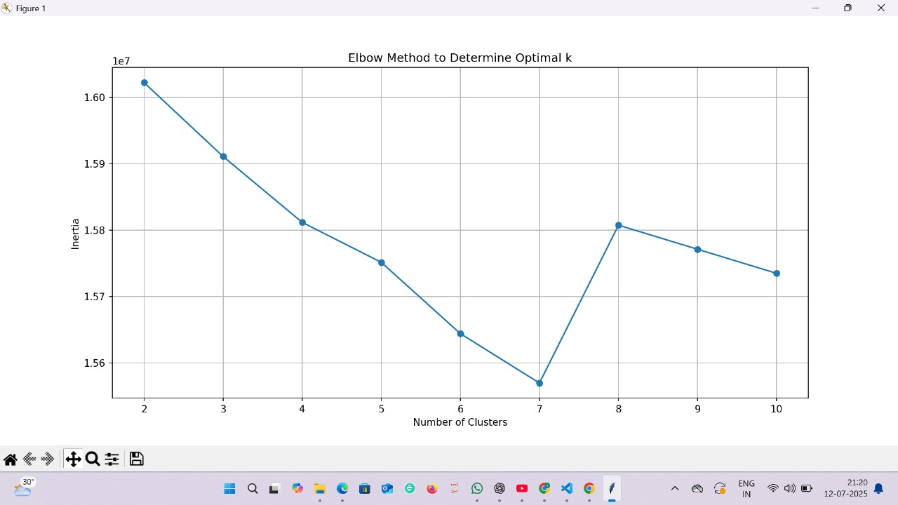

Slide 18
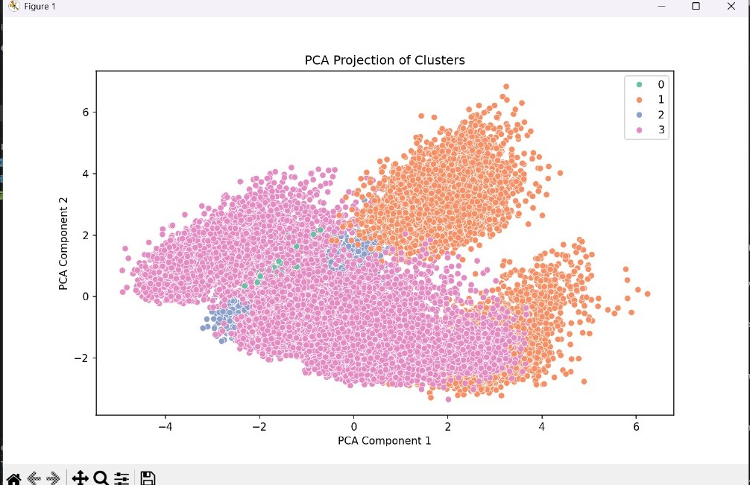

Slide 19
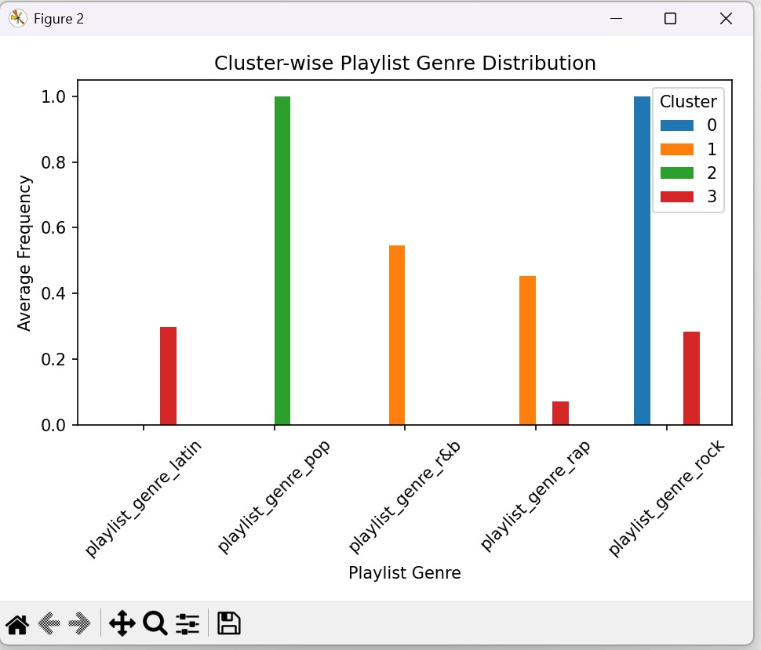

Slide 20
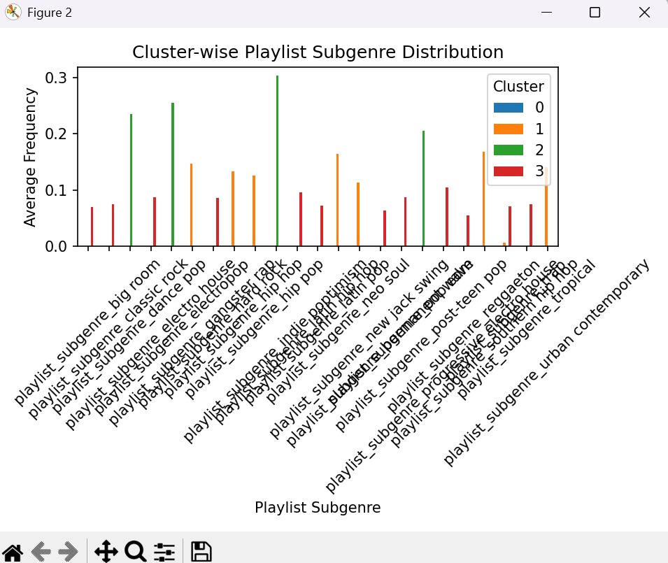

Slide 21
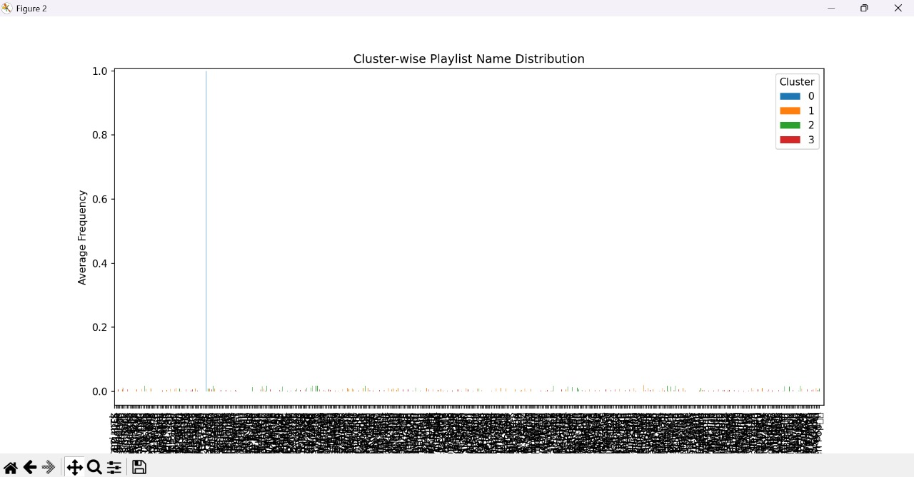

Slide 22
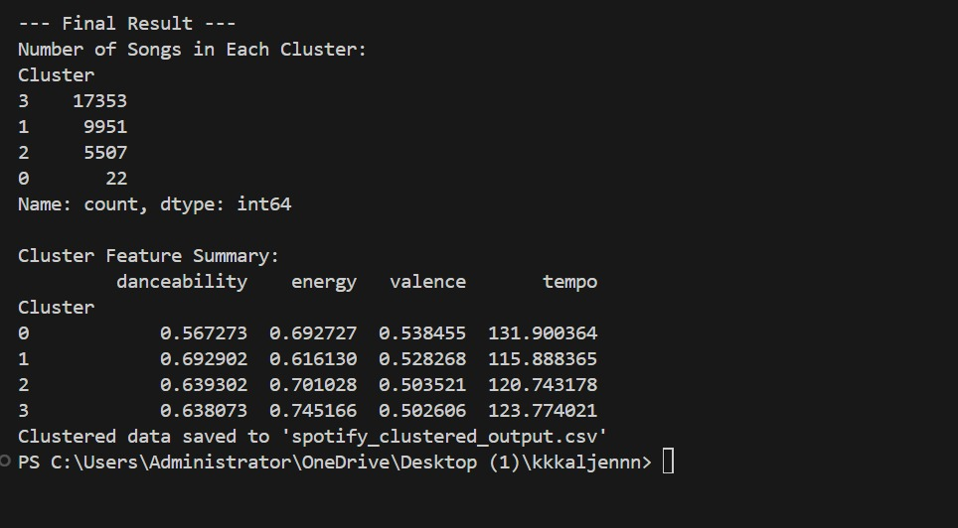

Slide 23
Results & Discussion
Clear separation of genres based on audio features.
Visualization of song clusters in 2D space.
Potential use in recommendation systems.

Slide 24
Conclusion
Successfully applied Unsupervised Learning (K-Means) to segment Spotify songs into meaningful clusters.
Audio features such as danceability, energy, and valence played a major role in genre differentiation.
PCA visualization confirmed that clusters exhibit distinct groupings in feature space.
The model can enhance music recommendation systems by grouping similar songs together

Slide 25
DONE BY
GUNTA RAJU

Slide 26
THANK YOU

